Slide 1
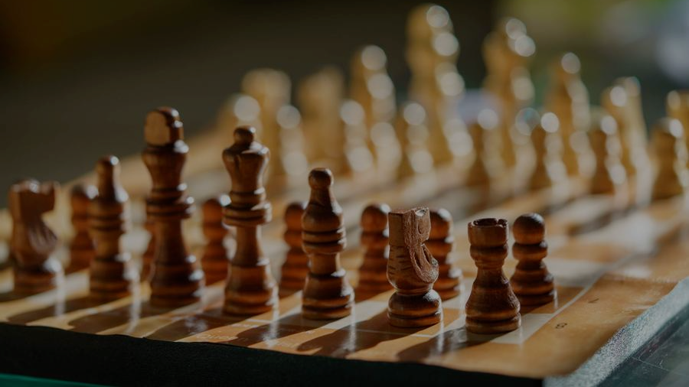
CHESSGPT
Presented by TEAM 20:
Layakishore Desireddy
Chetan Valluru
Bhavana Vemula

Slide 2

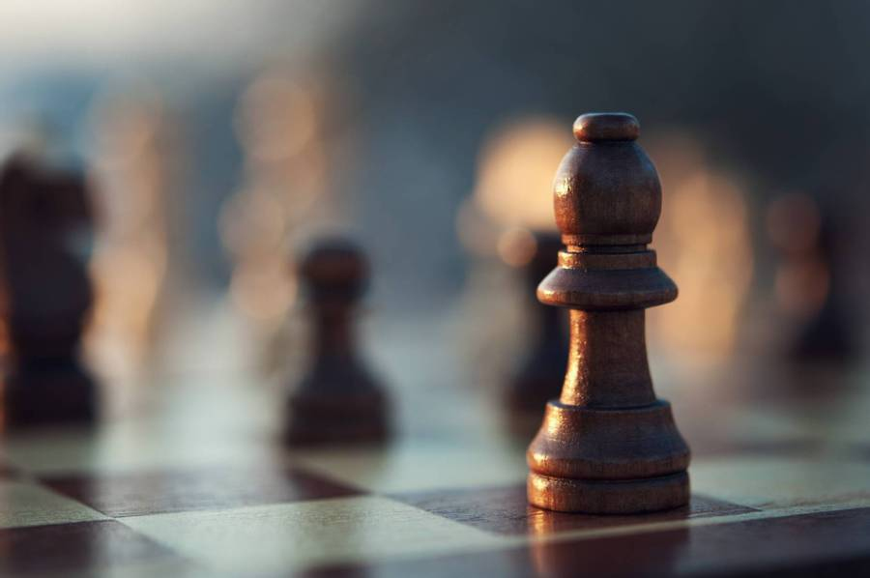
Objective: Develop an end-to-end chess move prediction system.
Select the best next move to maximize winning chances.
Use attention in transformers to consider previous moves as context.
Implement next-move prediction (causal language modeling) as the self-supervised learning objective.

Slide 3

Problems anticipated
Given that sequence prediction model doesn’t know how to play chess
A sequence prediction like text generation doesn’t have strict rules while generation as the generated text just needs to have required context but next word prediction doesn’t have to take all words strictly and decide a next word but that is not a case here
Will the model predict legal move ?
How many legal moves does model predict till it breaks ?
Will the model complete a game ?
Will model win ?

Slide 4
Data Preprocessing Steps
Filtering High-Quality Games:
Filters games where at least one player has an Elo rating above 2500, ensuring high-quality games.
1
Extracting Moves:
Removes move prefixes like "W1." and "B1." from the raw move data, leaving only the actual moves.
2
Removing PGN Data Features:
Focus solely on the sequence of moves by removing all PGN data features such as time, players, and results, retaining only the move sequences.
3
Adding Special Tokens:
Inserts `<bos>` for beginning of sequence, `<eos>` for end of sequence to help the model understand the start and end of the move sequence.
4

Slide 5
Sample Data Points
Before Processing:
After Processing :
[Event "F/S Return Match"]
[Site "Belgrade, Serbia JUG"]
[Date "1992.11.04"]
[Round "29"]
[White "Fischer, Robert J."]
[Black "Spassky, Boris V."]
[Result "1/2-1/2"]
[WhiteElo "2785"]
[BlackElo "2660"]
[TimeControl "40/7200:3600"]
[Termination "adjudication"]
e4 e5 2. Nf3 Nc6 3. Bb5 a6 4. Ba4 Nf6 5. O-O Be7 6. Re1 b5 7. Bb3 d6 8. c3 O-O 9. h3 Nb8 10. d4 Nbd7 11. c4 c6 12. Nc3 Qc7 13. a3 Bb7 14. Bg5 h6 15. Bh4 Rfe8 16. Rc1 Bf8 17. cxb5 axb5 18. Nxb5 Qb8 19. Nc3 exd4 20. Nxd4 c5 21. Nf5 g6 22. Ne3 Nxe4…..
<bos> e4 e5 Nf3 Nc6 Bb5 a6 Ba4 Nf6 O-O Be7 Re1 b5 Bb3 d6 c3 O-O h3 Nb8 d4 Nbd7 c4 c6 Nc3 Qc7 a3 Bb7 Bg5 h6 Bh4 Rfe8 Rc1 Bf8 cxb5 axb5 Nxb5 Qb8….<eos>

Slide 6
Model 1: Base GPT2
Architecture: Basic GPT-2 architecture with AutoTokenizer.
Training Data: Trained on processed chess game data containing only moves.
Capabilities: Predicts the next move given the game history.
Performance:
Max legal moves generated: 15.
Challenges: Compute-heavy model, irrelevant tokens (50,000 tokens, only 9% are chess moves).

Slide 7
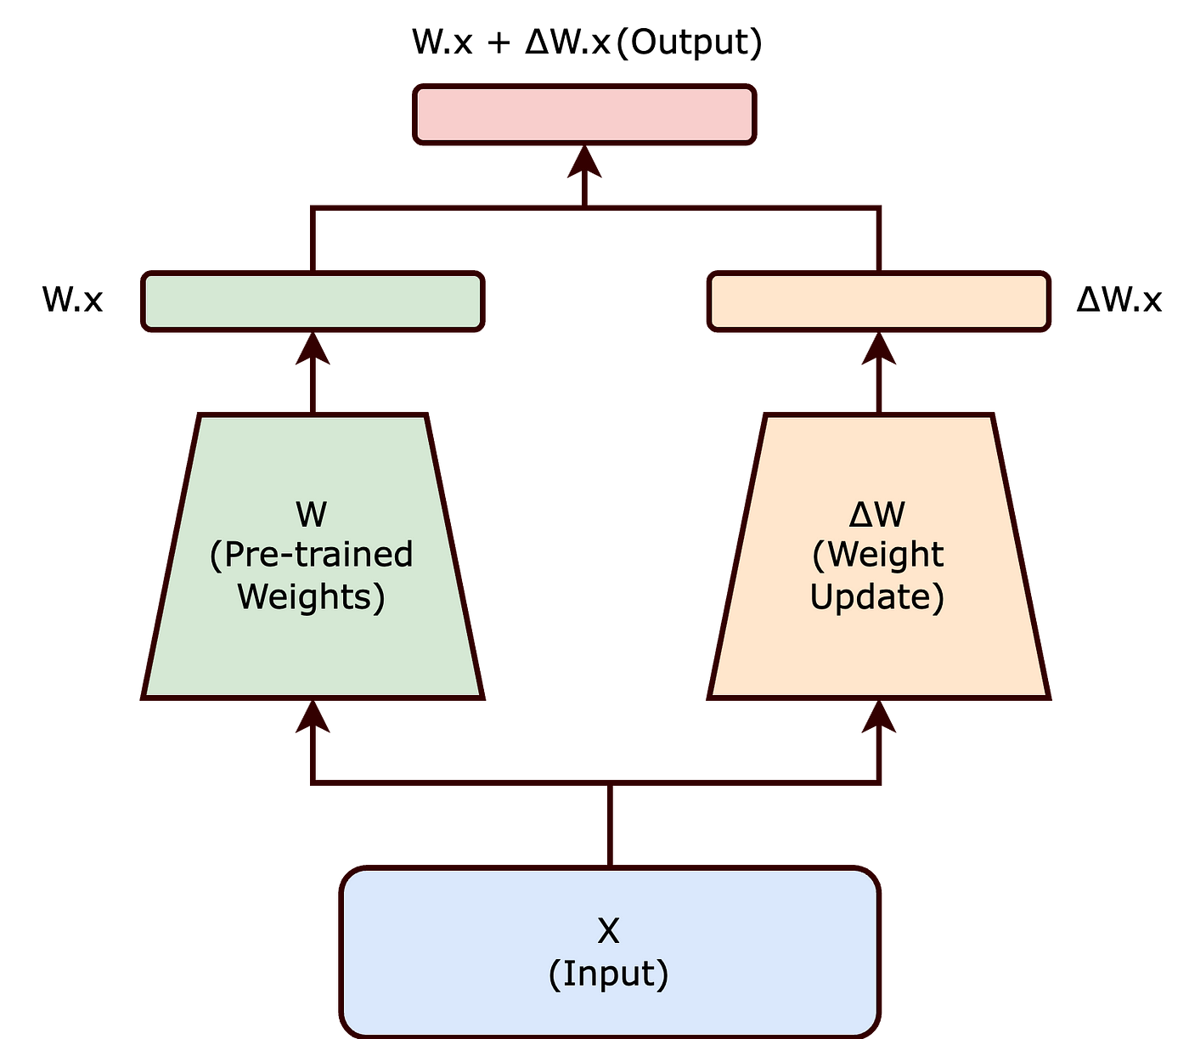
Model 2: Chess GPT (LoRA Fine-Tuning)
Architecture: GPT-2 with LoRA (Low-Rank Adaptation) for efficient fine-tuning.
Tokenizer: AutoTokenizer with additional tokens <bos> & <eos>
Capabilities: Efficient fine-tuning of large models with reduced computational resources.
- Faster Training, handling more data hence diverse moves.
Performance:
Max legal moves generated: 20.
Better results than Base GPT due to efficient fine-tuning.
Challenges: Irrelevant tokens (50,000 tokens, only 9% are chess moves).

Slide 8
Model 3: Chess GPT (Reinforced Fine-Tuning)
Architecture: GPT-2 with additional positional embeddings, custom tokenization and penalizing for illegal moves.
Training Data: Fine-tuned on chess games with custom tokens for game results and move identification.
Generates larger sequences, but are they winning moves? Generative models generate probable moves which are more frequent in data based on history of moves. But to win a game that is not enough, so additional measures are taken like:
Filtering for high-quality chess games, at least one player has an Elo rating above 2800 and the game has a decisive result (either a win for white or black).
Adds special tokens (<w> for white win and <b> for black win) to indicate the game result in the beginning of the moves sequence as context which helps model to generate tactical moves to win the game.
Capabilities:
Predicts plausible and legal chess moves.
Custom penalizing for illegal moves during training. Loss = Loss + 1
Performance:
Max winning legal moves generated: 27.
All tokens are relevant (about 5100 tokens).

Slide 9
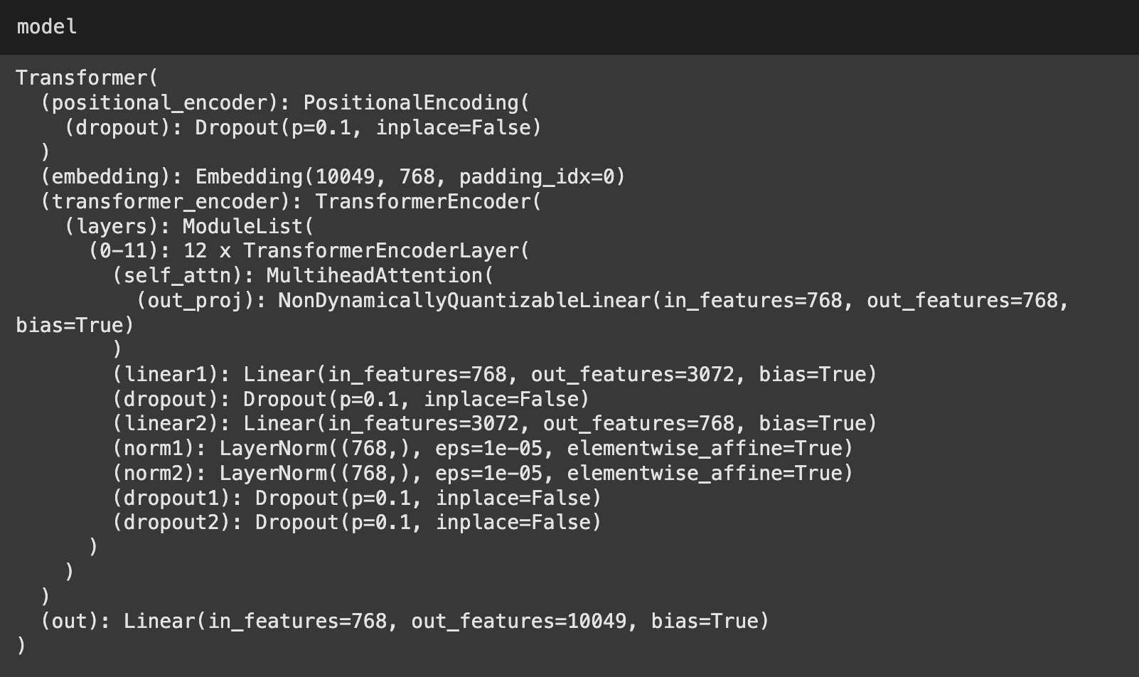
Model 4: Chess Transformers from Scratch
Architecture: Custom Transformer model built from scratch.
Tokenizer: Custom tokenizer for encoding chess moves.
Training Data: Trained on processed chess game data.
Capabilities:
Predicts the next move given the game history.
Implements positional encoding and self-attention mechanisms.
Performance:
Max legal moves generated: Completes the game!! Hurrayyy…
All tokens are relevant and optimized for chess moves.

Slide 10
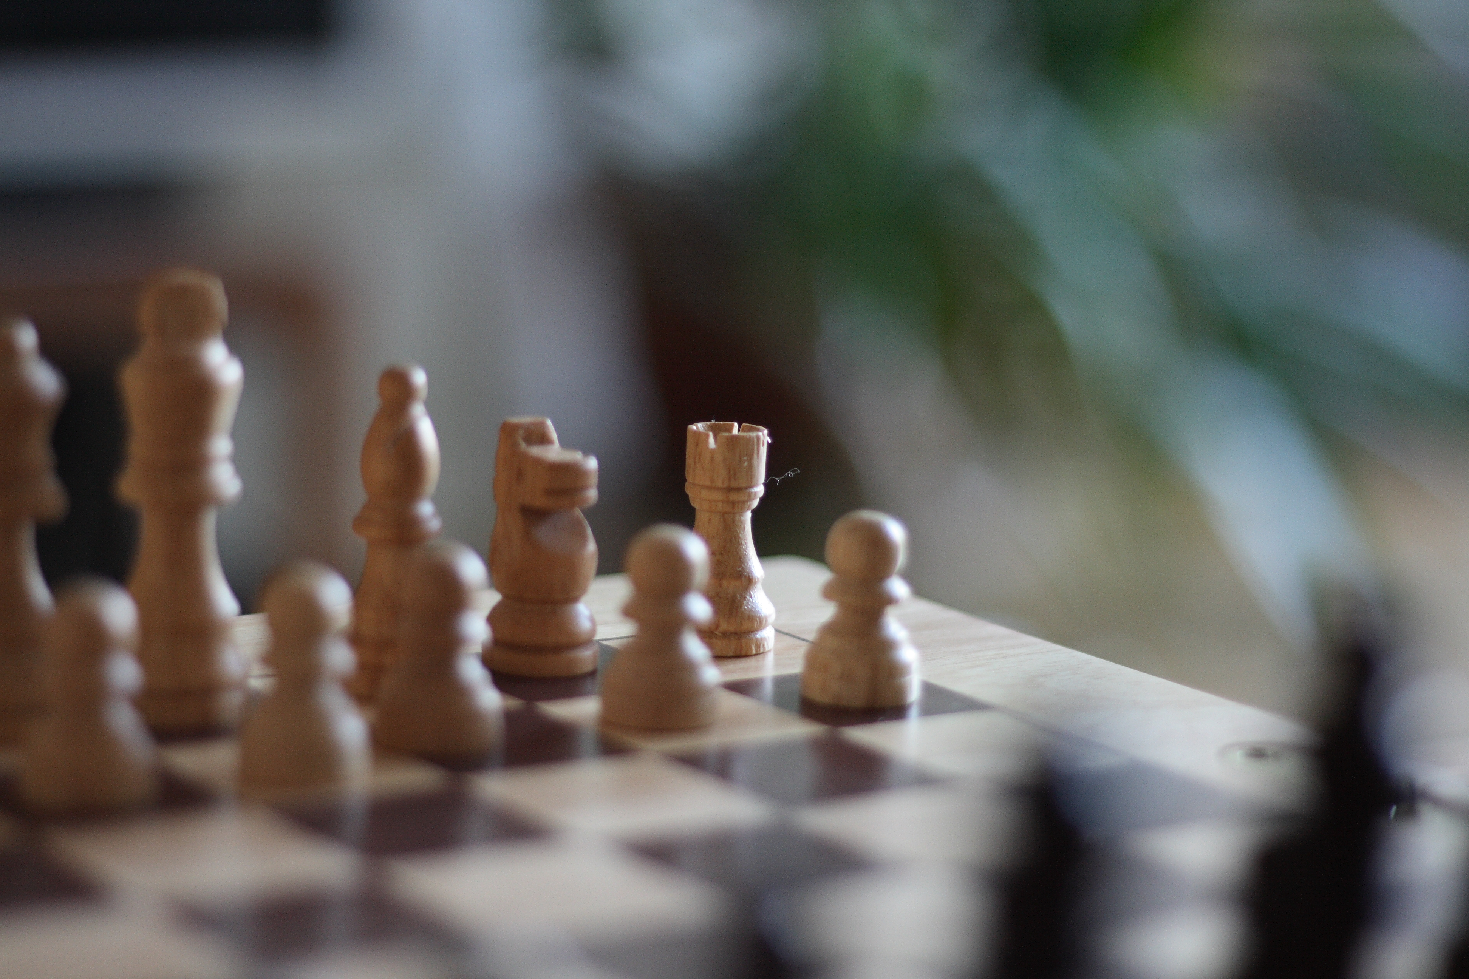
Why Model 4 is Better
Custom Architecture: Built specifically for chess move prediction, ensuring all tokens are relevant.
Optimized Tokenization: Custom tokenizer ensures efficient encoding and decoding of chess moves.
Performance:
- Higher accuracy in predicting legal moves.
- Better handling of game-specific scenarios due to custom training and architecture.
Efficiency:
- Efficient training and inference due to optimized model design.
- Reduced irrelevant tokens, leading to better utilization of computational resources.
Conclusion:
Model 4: Provides the best performance and efficiency for chess move prediction due to its custom architecture and optimized tokenization.
Future Work: Further fine-tuning and optimization can enhance the model's capabilities and accuracy.

Slide 11
Evaluation of Models
Basic Evaluation criteria: Completes the game? If No: No.of legal moves until model breaks
100 Games against stockfish, Model plays as white and vice versa
Output: Wins, Draws [80+ rule / 3 fold repetition / stale mate], Loses, resigns.
Number of best moves, good moves, mistakes and blunders categorized by Chess Engine.
Accuracy = (No.of best moves + good moves) / total No.of moves

Slide 12
Results:
Basic Evaluation:
Model 1:
Max legal moves generated: 15.
Model 2:
Max winning legal moves generated: 20.
Model 3:
Max winning legal moves generated: 27.
Model 4:
Max legal moves generated: Completes the game
100 Games Against StockFish: (Model plays White vs Black as StockFish) Final Game Statistics:
Total Games: 100
White Wins: 10
Black Wins: 19
Draws: 69
Unknown: 2
Insufficient Material: 0
80-move Rule: 62
Threefold Repetition: 4
Win Percentage: 10%
Draw Percentage: 69%
Loss Percentage: 19%
Games Analysis
Total White Good Moves: 192
Total White Mistakes: 84
Total White Blunders: 308
Total Black Best Moves: 257
Total Black Mistakes: 64
Total Black Blunders: 268
White Move Accuracy: 50.34%
Black Move Accuracy: 65%
Stalemate: 3
Detailed Draw Breakdown:
Total White Best Moves: 207
Total Black Good Moves:202

Slide 13
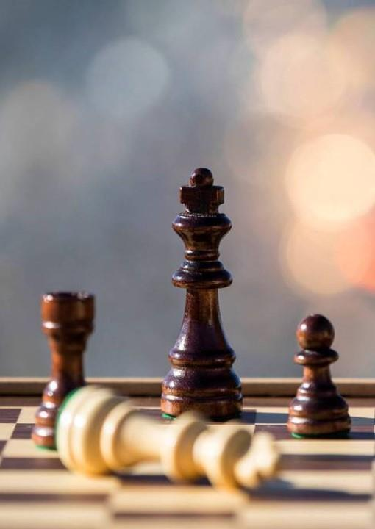
Thank You

